Slide 1
Big Basket mini project
PRESENTATION

Slide 2
Agenda
Introduction
Understanding the dataset
Hypothesis
EDA
Observation
Recommendation
Conclusion

Slide 3
project
introduction

Slide 4
Introduction
This project explores the e-commerce domain, specifically focusing on the analysis of data from Big Basket, India's largest online grocery platform.
Launched in 2011, Big Basket has consistently maintained its position as a market leader despite the emergence of competitors like Blinkit, thanks to its widespread popularity and a strong online presence.
E-commerce Overview:
Buying and selling goods online.
Key technologies: mobile commerce, electronic funds transfer, supply chain management, online transaction processing, etc.
Driven by advancements in the semiconductor industry.

Slide 5
What to expect ?
An overview of e-commerce and its technological backbone.
Exploratory Data Analysis (EDA) on Big Basket's dataset, featuring 10 key attributes, including product categories, pricing, brands, and customer ratings.
Insights derived from the dataset using Python libraries and data visualization tools.

Slide 6
Understanding the dataset

Slide 7
Dataset description
Dataset Description:
Contains 10 attributes.
Captures essential aspects of e-commerce data.
Attributes:
Index: Row identifier.
Product: Product title.
Category: Main category of the product.
Sub-category: Subdivision under the main category.
Brand: Product brand.
Sale Price: Discounted price.
Market Price: Original market price.
Type: Classification type.
Rating: Customer rating.
Description: Textual data details.

Slide 8
Key steps to perform

Slide 9
Key steps to perform
Load Dataset.
Use head function to look for first 12 rows.
Get Description of the data in the Data Frame.
Find Information about the Data Frame.
5. Find out the Missing Values from the Dataset and treat them.
6. Find out the outliers from the dataset and treat them.
7. Find out Top & least sold products.
8. Measuring discount on a certain item.
9. Create Plots or visualizations
10. Hypothesis

Slide 10
Hypothesis

Slide 11

Hypothesis 1
Beverages Are the Most Popular and Highly Rated Category Apart From Fresh Groceries Category.
Rating based on category Beverages – 4.08

Slide 12
Hypothesis 2
Higher Discounts Lead to Lower Product Ratings
Based on correlation between Discount% and Rating, we found that the correlation between them is around 0.

Slide 13
Hypothesis 3
Premium Brands Offer Fewer Discounts.
Validation - We’ve analyzed the average discount percentage across different brands.

Slide 14
Exploratory Data Analysis

Slide 15
EDA
Top Selling Product -- Turmeric Powder/Arisina Pudi
Least Selling Product -- Green Tea - Pure Original

Slide 16
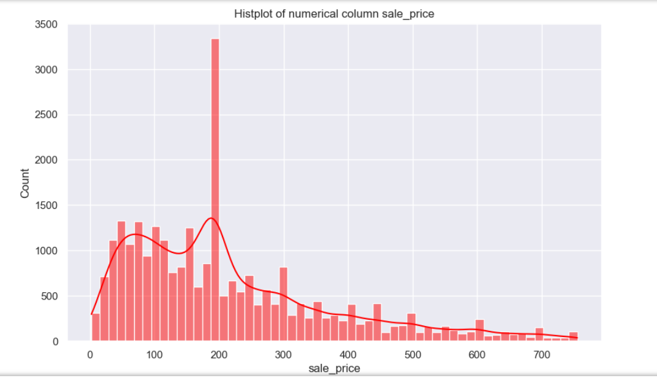
EDA - Graphics

Slide 17
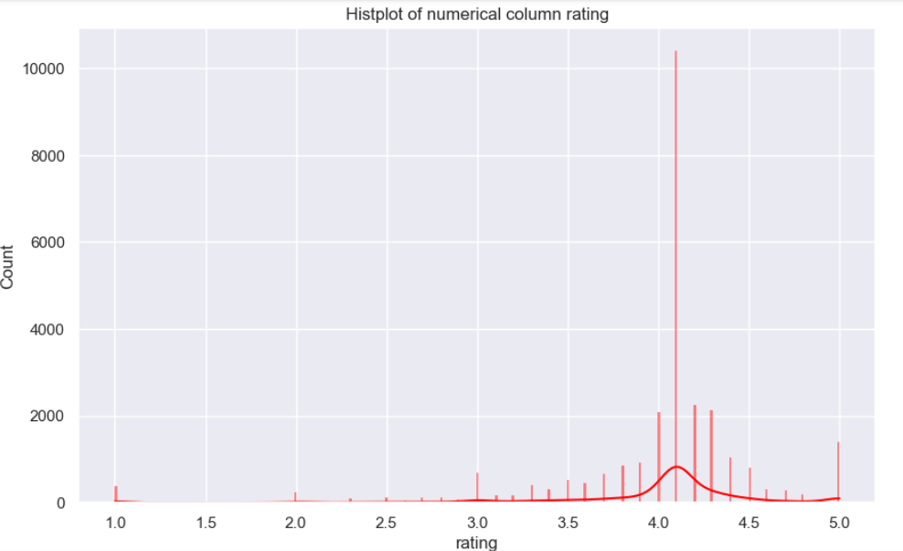
EDA - Graphics

Slide 18
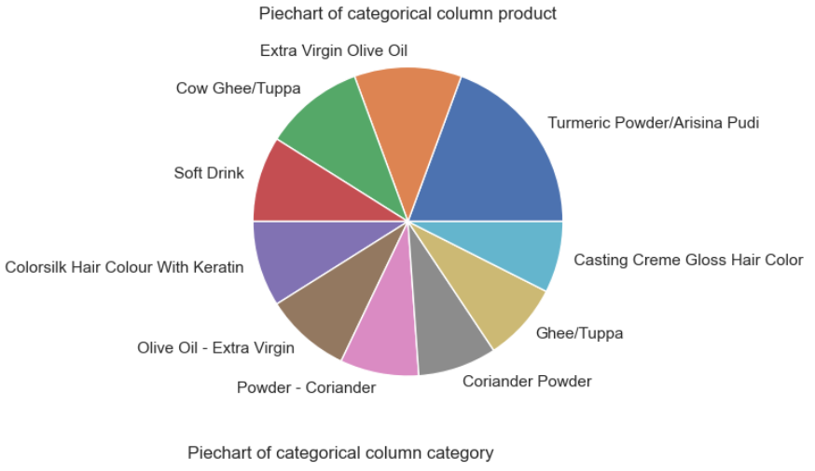
EDA - Graphics

Slide 19
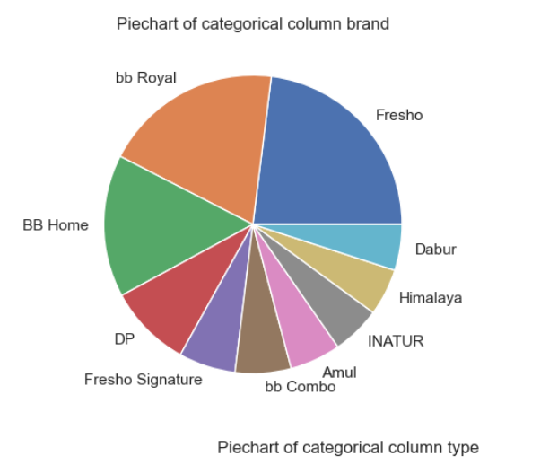
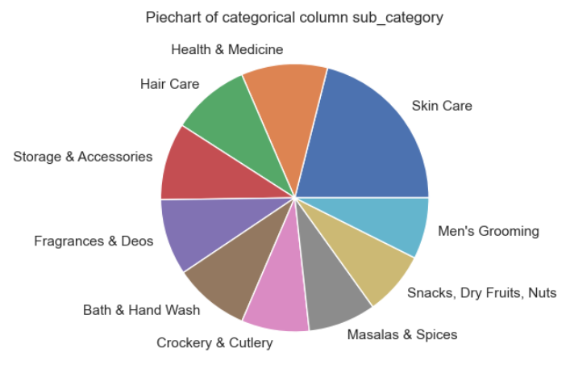
EDA - Graphics

Slide 20
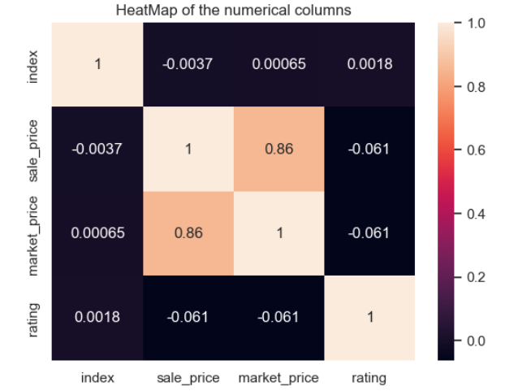
EDA - Graphics

Slide 21
Observations
Beverages is the highest-rated category with an average rating of 4.08, indicating strong customer satisfaction.
There is no significant correlation between higher discounts and lower ratings (-0.0027 correlation).
Some brands provide zero discounts
Foodgrains, Oil & Masala (4.06) and Baby Care (4.02) are also among the top-rated categories.

Slide 22
Recommendation
Leverage High-Rated Categories:
Promote and expand product offerings in Beverages, Foodgrains, and Baby Care, as these categories have the highest customer satisfaction.
Refine Discount Strategies:
Since discounts do not significantly impact ratings, focus on value-driven pricing rather than excessive discounts.
Improve Ratings for Low-Rated Categories:
Conduct customer surveys for Kitchen, Garden & Pets (3.73) and Beauty & Hygiene (3.93) to identify areas for improvement.

Slide 23
conclusion
Beverages leads in customer satisfaction, making them a high-priority category for marketing and sales strategies.
Discounting does not significantly impact ratings, so brands should focus on quality and customer experience instead.
Optimizing the product mix based on customer ratings can enhance sales and brand reputation.

Slide 24
THANK YOU

